Slide 1

Introduction to MySQL Database Terms in PHP
MySQL is a popular and robust open-source database management system, while PHP is a versatile scripting language widely used for web development. Together, they form a powerful foundation for building dynamic and interactive websites with persistent data storage.

Slide 2

Database Fundamentals
A database is an organized collection of data, typically stored and accessed electronically. It's crucial for managing information efficiently and ensuring data integrity.
Tables
Rows
Tables are the fundamental building blocks of a database, organized into rows and columns to store data in a structured manner.
Each row in a table represents a single record, containing information about a specific entity, such as a customer or product.
Columns
Relationships
Columns define the attributes or characteristics of the data stored in each row, providing a clear structure for the information.
Relationships establish connections between different tables based on shared data, allowing for efficient data retrieval and manipulation.

Slide 3

SQL Queries
Structured Query Language (SQL) is the standard language used to communicate with databases, enabling us to retrieve, insert, update, and delete data.
1
SELECT
2
INSERT
Extracts data from a database, allowing you to retrieve specific information based on defined criteria.
Adds new data into a database table, expanding the information stored.
3
UPDATE
4
DELETE
Modifies existing data within a database table, allowing for data correction or changes.
Removes data from a database table, ensuring data integrity and removing obsolete information.

Slide 4
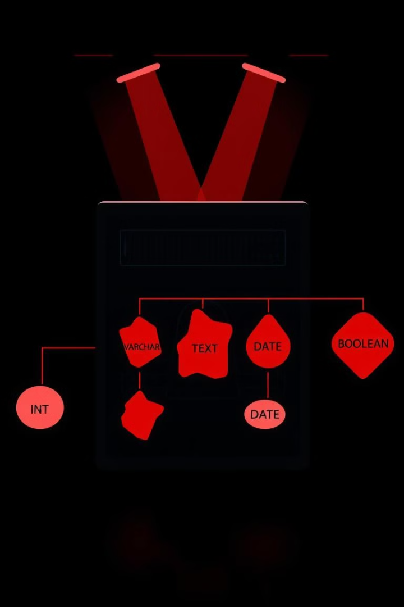
Data Types in MySQL
MySQL offers a range of data types to store different kinds of information effectively, ensuring data integrity and efficiency.
INT
Stores whole numbers, perfect for representing quantities or IDs.
VARCHAR
Stores variable-length strings of text, suitable for names, addresses, or descriptions.
TEXT
Stores large amounts of text data, ideal for lengthy descriptions or articles.
DATE
Stores calendar dates, useful for tracking events or time-sensitive data.
BOOLEAN
Stores true or false values, representing logical states or binary choices.

Slide 5




MySQL Syntax and Statements
Understanding MySQL syntax and statement structure is crucial for effectively communicating with the database, ensuring correct data manipulation.
CREATE TABLE
Defines a new table in the database, specifying its structure and data types.
ALTER TABLE
Modifies the structure or data types of an existing table, adapting it to changing requirements.
DROP TABLE
Deletes an existing table from the database, removing its data and structure.

Slide 6
Database Connections in PHP
Establishing a connection between PHP and MySQL is essential for retrieving and manipulating data, enabling dynamic web applications.
MySQLi Extension
PDO (PHP Data Objects)
Connection Parameters
Provides a robust and secure way to connect to MySQL databases, offering a wide range of features.
Offers a database-agnostic approach, allowing you to interact with multiple database systems using a consistent API.
Include information like the hostname, database name, username, and password to establish a successful connection.

Slide 7
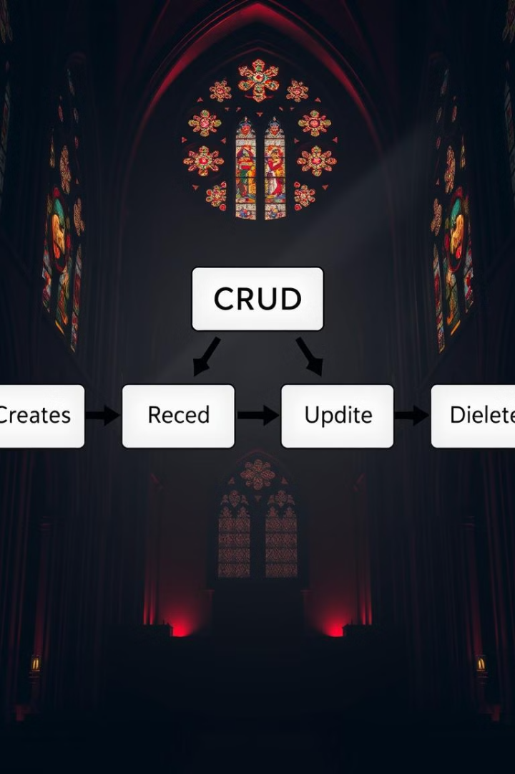




CRUD Operations in PHP
CRUD operations (Create, Read, Update, Delete) are fundamental actions performed on data within a database, enabling comprehensive data management.
Create
Read
Insert new data into a database table, expanding the stored information.
Retrieve existing data from a database table, providing access to stored information.
Update
Delete
Modify existing data within a database table, ensuring data integrity and accuracy.
Remove data from a database table, ensuring data integrity and removing obsolete information.

Slide 8

Understanding MySQL database terms and PHP integration is fundamental for web developers. By mastering this knowledge, you'll be able to build dynamic websites with seamless data management capabilities.
Database Fundamentals
1
Grasp the core concepts of databases, tables, rows, columns, and relationships.
2
SQL Queries
Learn SQL commands for interacting with databases, including SELECT, INSERT, UPDATE, and DELETE.
Data Types and Syntax
3
Understand data types available in MySQL and the correct syntax for database statements.
4
PHP Integration
Establish connections between PHP and MySQL databases, enabling data retrieval and manipulation.
CRUD Operations
5
Master the CRUD operations for creating, reading, updating, and deleting data in databases.

